Slide 1

CAPSTONE PROJECT GROUP 8
SUBMITTED TO : MUHAMMED SHAHID
SUBMITTED BY : SOORYA SURESH - 0735168
: TEJAS PATEL - 0734912
SUBMITTED ON : 10TH APRIL 2020

Slide 2




PREDICTING TRAFFIC FATALITIES IN CANADA USING MACHINE LEARNING

Slide 3
INTRODUCTION
Traffic accidents are extremely common. Because of its increasing frequency traffic accidents are a major cause of death globally. Their occurrence is influenced by a multitude of factors.
The dataset is open, and it is in coded format and we are going to look at what are the major factors responsible for fatal and nonfatal injuries .
We will do classification model on this which will be able to give best prediction.

Slide 4
How we started our Journey….
We shortlisted some possible contacts via web
Service Ontario, city of Windsor, Windsor police, City of Toronto
We contacted all these centres.
After a lot of struggle we finally succeeded in achieving our dataset through opengov.ca

Slide 5
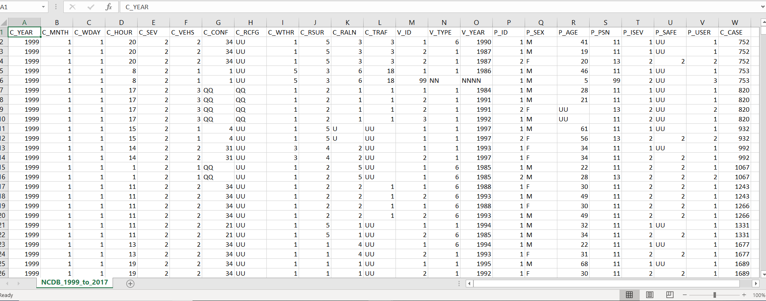
ABOUT THE DATASET
There are 6.77 million rows and 23 columns in our dataset.
All features are in categorical data with one feature having only two categories (C_SEV)
While some are having more than 30+.
All the features in our dataset are depicted in code format.

Slide 6
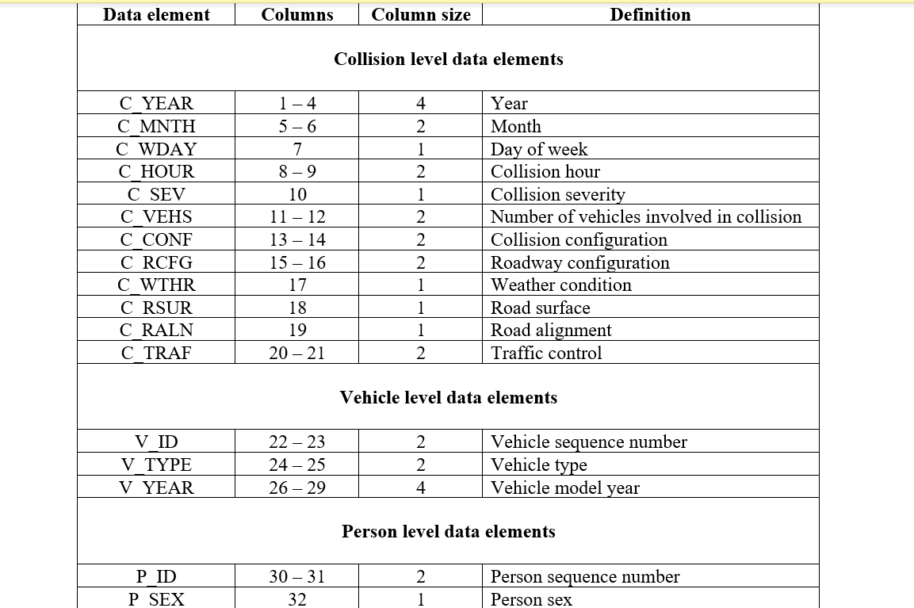
DATASET DICTIONARY
Along with our dataset we have an NCB dictionary which clearly explains about each feature.

Slide 7
ABOUT THE THESIS STATEMENT
Transportation is important as it enables communication, trade and exchange of goods and services across the globe. But at the same time growth of transportation has very unfortunate impact on the society in terms of accidents.
Data analytics can provide an in-depth knowledge of methods for analyzing and implementing intelligent transportation systems.

Slide 8
HYPOTHESIS OF OUR PROJECT
Our hypothesis says weather and road configuration are the major factors contributing road accidents in Canada. Its clear as Canadian winter weather can plays a huge role in traffic accidents.
Traffic accidents can cause physical, financial and mental effects for everyone involved. Drivers and passengers can suffer from minor cuts and bruises to broken limbs, back and spinal injuries, paralysis and even death.

Slide 9
ETHICS RELATED TO PROJECT
Before starting the project, we have checked for the consent like this dataset was available on opengov.ca which is open data source website which provides us with Canada data, and it has data from wide area. And this website provides open data for public so we can participate and gives our valuable insights from the data.
We will provide every possibility to public and Canada authority if they request us to not use any kind of information from the dataset, then we will remove it but as I mentioned that this is public data and is openly available for residents of Canada to use for improvement of the country, but after completion of project if they request us to not to use any kind of information we will not use it for our analytic work

Slide 10
WORKS ON PYTHON
At first, we imported the necessary libraries and read the file
There ARE 6.77 Million rows and 23 columns

Slide 11
DATA CLEANING
1. Filtered data from year 2012
2. The number of rows got reduced to 1849249 (1.85 Million) rows for the years 2012- 2017
3. There was no null values in the dataset
4. Dropped all unknown values from the dataset(UU,XX)
5. Now the number of rows got reduced to 1051219
6. Converted the dates columns as index
7. Dropped unwanted columns which won't be able to help in predicting the model
8. Now there are 1051219 (1.05 Million) rows and 19 columns

Slide 12
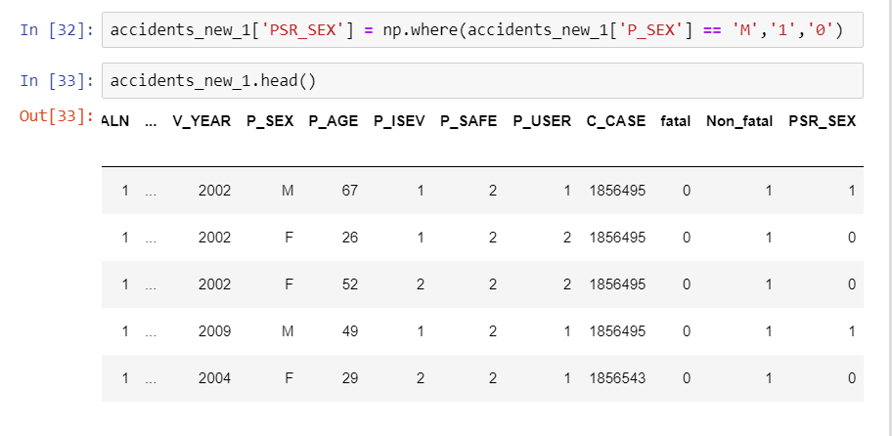
DATA CLEANING
Since the P_SEX column was categorical, and it has characters in it.
So to convert it to integer we made a new column PSR_SEX. using np.where which will help in assigning the associated value 1 for male and 0 for female.

Slide 13
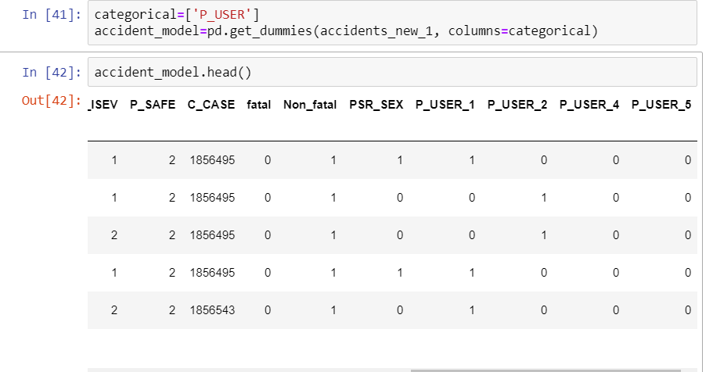
DATA CLEANING
We applied one hot encoding to the column P_USER (road user class) for creating more features to improve the model performance and generalize the data better. This can only be applied to categorical columns.
This will help us find which user is more prone to accidents and will help in giving better result for column P_ISEV (medical treatment required) The column is represented in codes where
code 1 – motor vehicle driver
code 2 – motor vehicle passenger
code 3 – pedestrian
code 4 –Bicyclist
code 5 – Motorcyclist
There is no column for P_USER_3 because no pedestrian was involved in accidents in the data

Slide 14
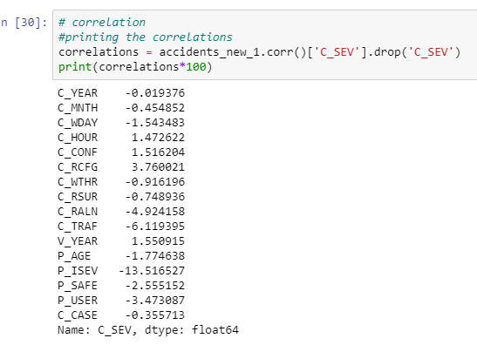
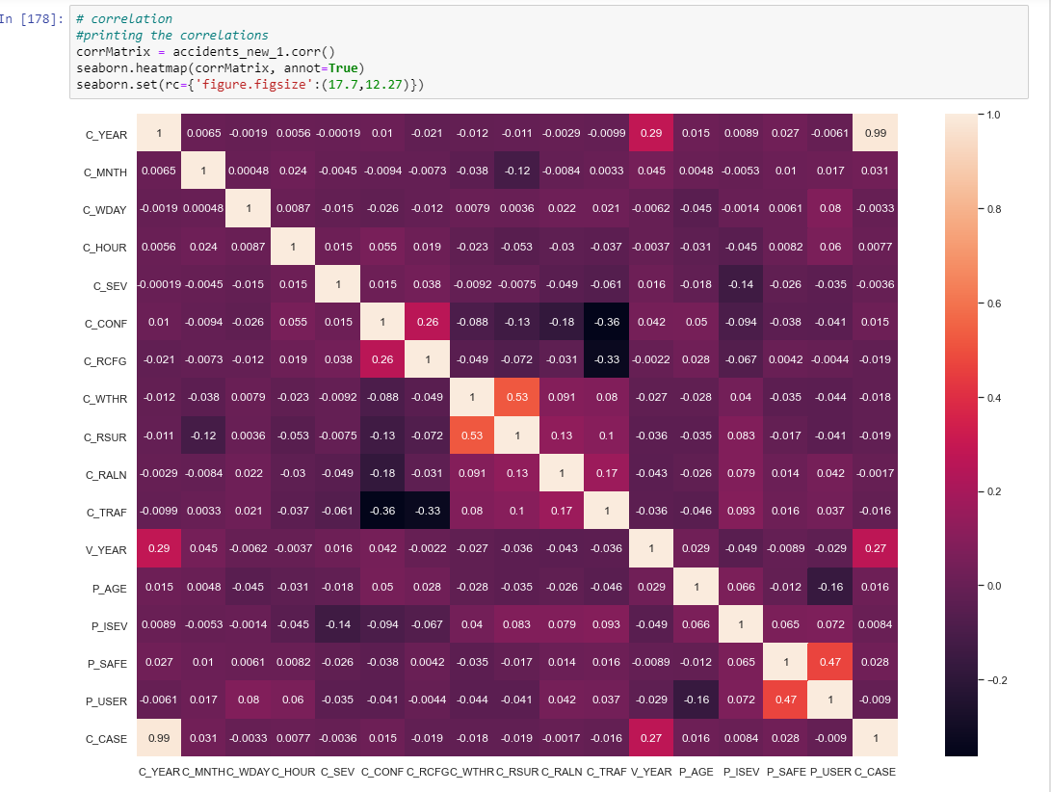
CORRELATION MATRIX
1. There are columns which are positively correlated and negatively correlated
2. The most positively correlated attribute is C_RCFG (collision road configuration) and the most negatively correlated attribute is P_ISEV (passenger medical treatment required)
3. Got the number of fatal and nonfatal accidents by grouping according to date

Slide 15
EXPLORATORY DATA ANALYSIS
to find the pattern from the data and to test our hypothesis by using visualization charts

Slide 16
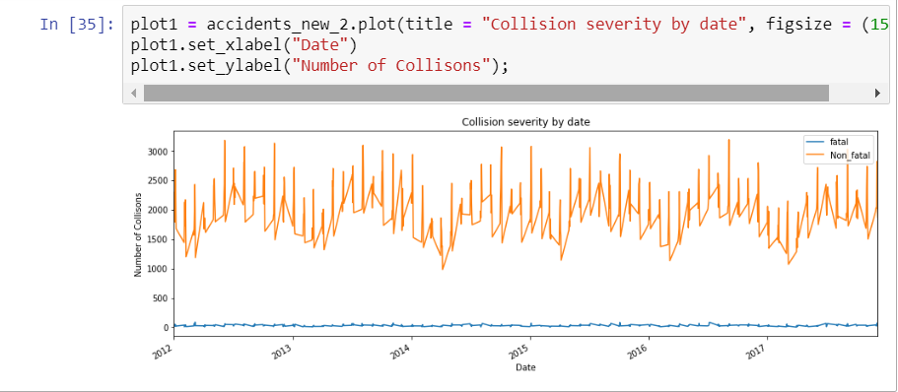
SEVERITY OF COLLISSION ANALYSIS
Plotted a chart on collision severity by date
From the chart we can see that it illustrates seasonal behavior within the data

Slide 17
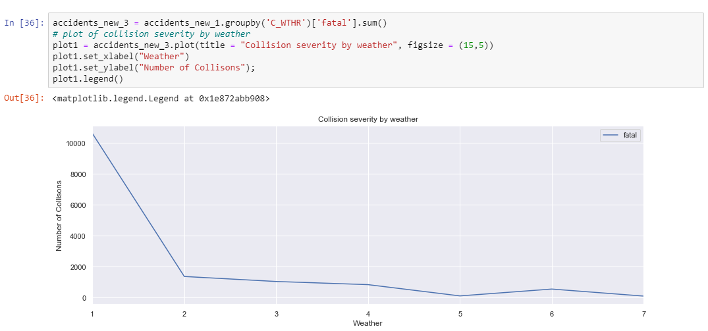
COLLISION SEVERITY BY WEATHER
The graph shows severity of collision due to weather.
From the graph we can understand that number of fatal deaths due to weather is more than 10k and is higher during clear and sunny day and lowest during freezing rain and strong wind days.
1 - Clear and sunny
2 - Overcast, cloudy but no precipitation
3 - Raining
4 - Snowing, not including drifting snow
5 - Freezing rain, sleet, hail
6 - Visibility limitation eg: drifting snow, fog, smoke, mist, dust
7 - Strong wind

Slide 18
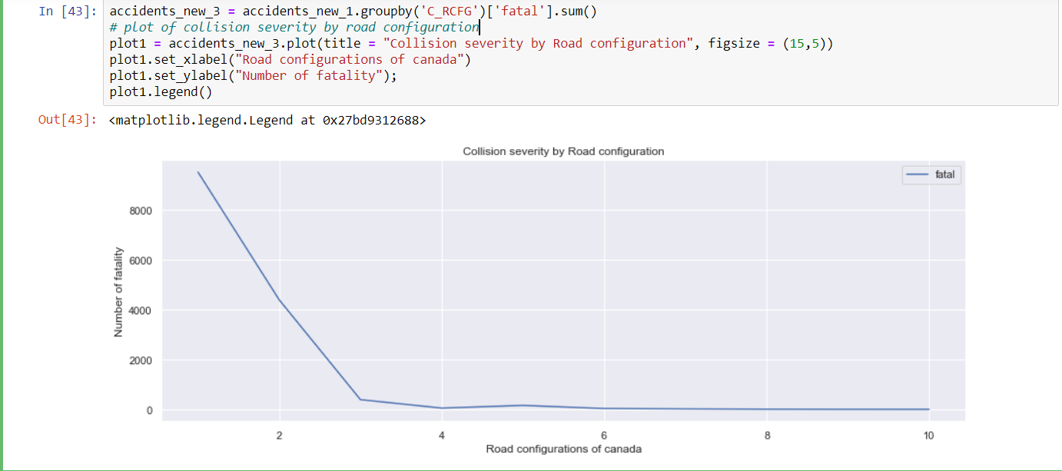
COLLISION SEVERITY BY ROAD CONFIGURATION From the graph we can understand that fatalities due to road configuration is more than 8k which is at non-intersection and at an intersection of at least two public roadways. Other reasons are having no much impact to collisions.
1 – Non-intersection
2 - At an intersection of at least two public roadways
3 - Intersection with parking lot entrance/exit, private driveway or laneway
4 - Railroad level crossing
5 - Bridge, overpass, viaduct
6 - Tunnel or underpass
7 - Passing or climbing lane
8 - Ramp
9 - Traffic circle
10 - Express lane of a freeway system
11 - Collector lane of a freeway system
12 - Transfer lane of a freeway system

Slide 19
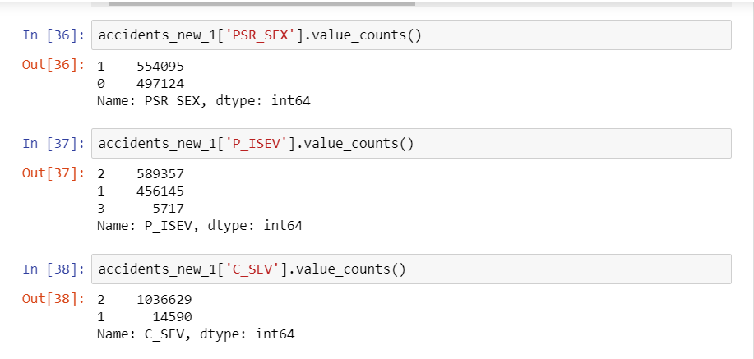
DATA ANALYSIS
From the column PSR_SEX we found the count of number of males 554095 and that for females 497124
From the column P_ISEV(Medical treatment required) which is represented in codes 1,2,3. We got the count for:
Code 1- No injury – 456145
Code 2- injury – 589357
Code 3- Fatality- 5717
From the column C_SEV(collision severity)which is also represented in codes we found the count for:
Code 1- collision producing at last one fatality- 14590
Code 2- collision producing nonfatal injury - 1036629

Slide 20
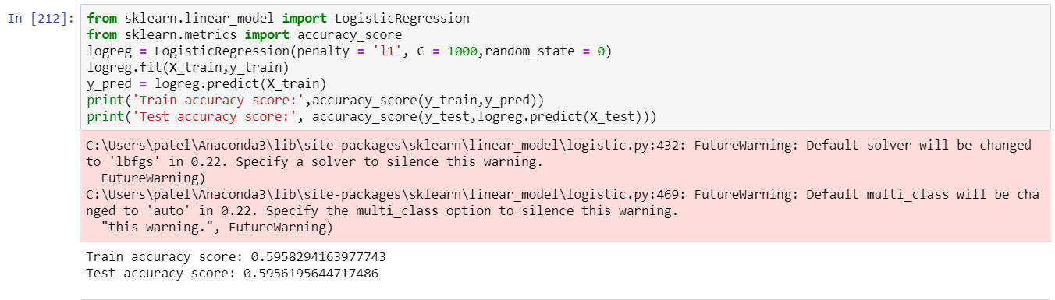
LOGISTIC REGRESSION
Logistic regression is a statistical model that in its basic form uses a logistic function to model a binary dependent variable, although many more complex extensions exist.
We imported necessary libraries and Min Max scaler for feature transformation and split the data into train and test
We tried Logistic Regression and got 59% accuracy for both training and test.

Slide 21
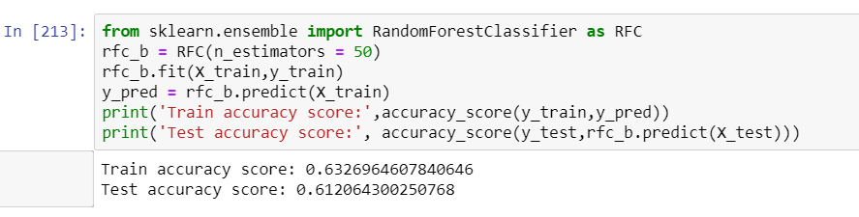
RANDOM FOREST CLASSIFIER
The random forest is a classification algorithm consisting of many decision trees.
Using Random Forest we got 63% accuracy for training and 61% accuracy for test.
We tried n= 100 and got this accuracy. After that there was no improvement. So, we took this accuracy.

Slide 22
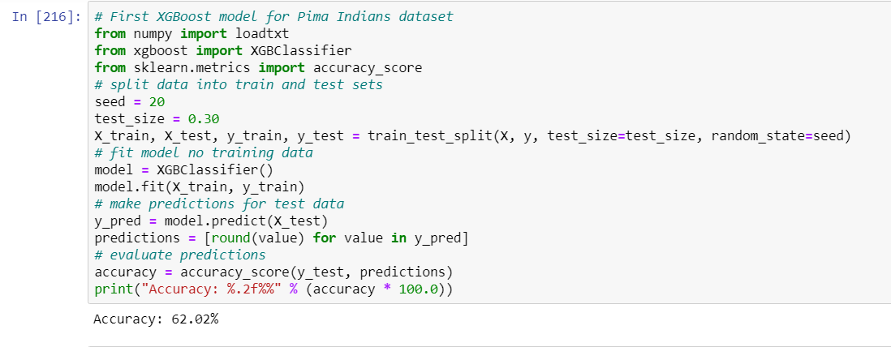
XG BOOST CLASSIFIER
XGBoost is a decision-tree-based ensemble Machine Learning algorithm that uses a gradient boosting framework.
In XG Boost classifier, we used the seed and was able to get an accuracy of 62%

Slide 23
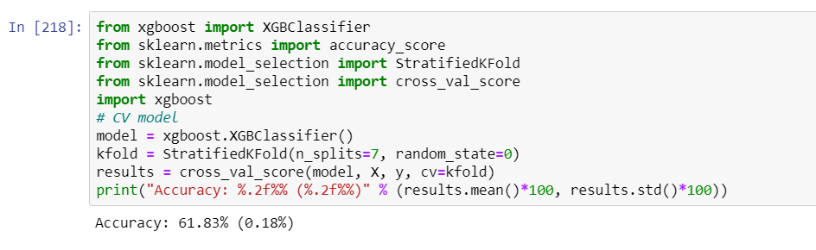
XG BOOST CLASSIFIER WITH KFOLD
In XG Boost classifier using cross validation, we took kfold of 7 and the accuracy was low to 61.83%.
We tried Kfold of 5 and 10 also but the best accuracy we got was with kfold 7.
By this accuracy score we got to know that our average cross validation score is not that high, there can be splits for which the classifier performed significantly less.

Slide 24
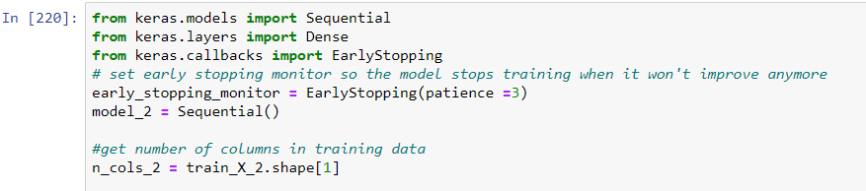
NEURAL NETWORK
The model type we used is Sequential.
Sequential is the easiest way to build a model in Keras. It allows you to build a model layer by layer. Each layer has weights that correspond to the layer the follows it.
‘Dense’ is the layer type. Dense is a standard layer type that works for most cases.
Early stopping will stop the model from training before the number of epochs is reached if the model stops improving. We will set our early stopping monitor to 3.

Slide 25
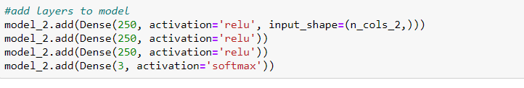
NEURAL NETWORK
We use the ‘add()’ function to add layers to our model. Activation’ is the activation function for the layer. An activation function allows models to consider nonlinear relationships. The activation function we will be using is ReLU or Rectified Linear Activation and Softmax. ReLU is two linear pieces, it has been proven to work well in neural networks. Softmax makes the output sum up to 1 so the output can be interpreted as probabilities.

Slide 26
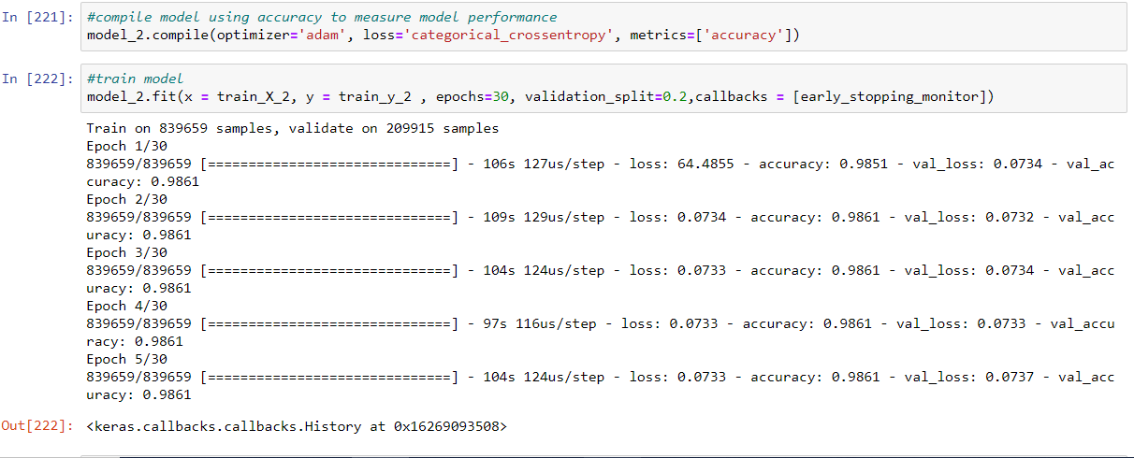
NEURAL NETWORK
The optimizer controls the learning rate. We will be using ‘adam’ as our optimizer. In our dataset as our column C_SEV has 1 and 2 so when we will do it's one hot encoding then it will convert in binary code so it will take 3 values for it that's why it will show 3 value.
We will use categorical_crossentropy’ for our loss function. This is the most common choice for classification.
Keras proportionally split your training set by the value of the variable. The validation split variable in Keras is a value between [0..1]. We got the highest model accuracy for neural network that is 98.6%.

Slide 27
CONCLUSION
In this study we conducted an analysis on traffic fatalities and factors responsible for the increasing number of deaths in Canada using open data provided by Opengov.data.
Using the dataset we build traffic fatality prediction models using Supervised Learning Algorithms.
Our best model can predict 98.6% of traffic fatalities and predict the number of collision and factors responsible for the deaths in Canada.
Our analysis can be used to identify the major reason for death due to road configuration and extreme climatic condition in order to take action to reduce the risk of accidents.
we believe that our work can easily be reproduced for other countries and cities under the condition that similar datasets are available
Finally, our study shows that open data initiatives are useful to society because they make it possible to study critical issues like road accidents.

Slide 28
REFERENCES
https://github.com/sooryasuresh-star/capstone-project
Service Ontario, Windsor police, city of Windsor
Open.canada.ca. (2020). National Collision Database - Open Government Portal. [online] Available at: https://open.canada.ca/data/en/dataset/1eb9eba7-71d1-4b30-9fb1-30cbdab7e63a [Accessed 5 Mar. 2020]
GitHub: https://github.com/sooryasuresh-star/capstone-project

Slide 29

THANKYOU

Slide 30
ANY QUESTIONS?

